Slide 1

Dispersion Modeling
Ariel Stein
Air Resources Laboratory
June 21, 2016
Notes:
In this presentation I will describe the research and application activities related to transport and dispersion modeling.

Slide 2
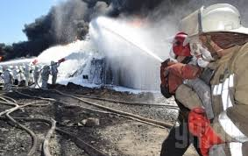
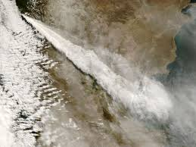
Background
The accidental or intentional release of chemical, biological, or nuclear agents or the eruption of volcanic ash can have significant health, safety, national security, economic, and ecological implications.
We want to understand and predict how, where, and when harmful materials are atmospherically transported and deposited
65+ years of research experience
Conducted across all divisions of the Lab
Notes:
The atmospheric release of a hazardous substance could significantly affect the health, safety, security, economy, and natural resources of our country and the rest of the world.
Understanding and predicting how, where, and when harmful materials are atmospherically transported and deposited is essential for responding appropriately to prevent disaster and protect the health and welfare of the general public and emergency response personnel.

Slide 3
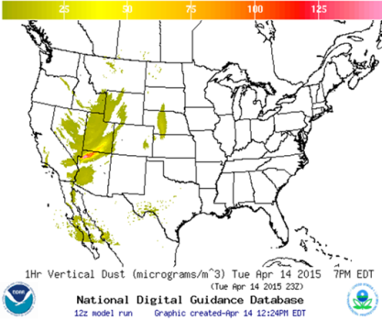
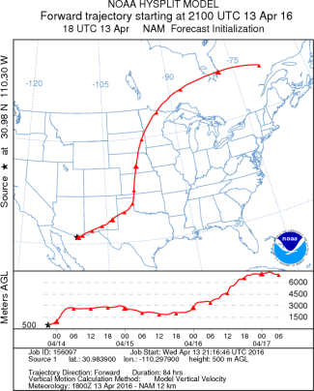
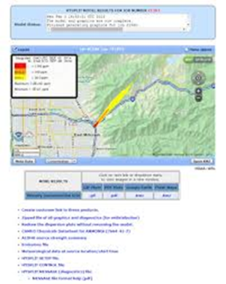
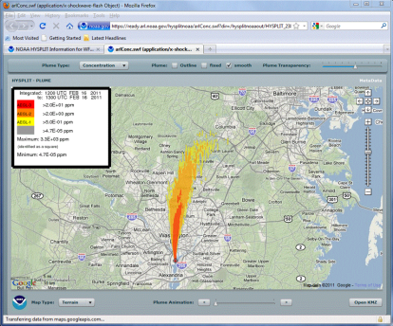
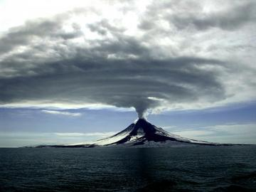
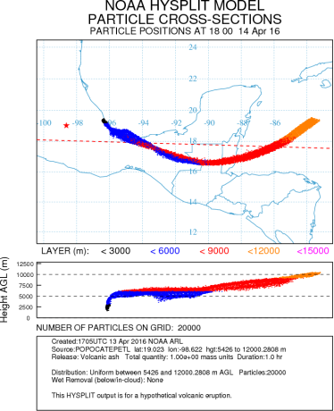
NOAA’s Responsibilities Require Atmospheric Transport and Dispersion Predictions
NOAA operates two of nine Volcanic Ash Advisory Centers in support of International Civil Aviation Organization
NOAA operates a Regional Specialized Meteorological Center (RSMC) to support World Meteorological Organization (WMO)
Local National Weather Service’s Weather Forecast Offices (WFO) provide dispersion predictions to local emergency managers
Consequence assessment support for DOE’s Idaho National Laboratory and Nevada National Security Site.
Modeling support to Nuclear Regulatory Commission (NRC) for their MELCOR Accident Consequence Code System (MACCS)
ARL continuously develops and updates NOAA’s operational model for dispersion applications
Notes:
NOAA has multiple responsibilities that require the use of atmospheric transport and dispersion modeling tools.
In my introductory talk I have already described some of these responsibilities. However, it is worth highlighting here that Local NWS Weather Forecast Offices (WFO) rely on HYSPLIT to provide dispersion predictions to local emergency managers who are dealing with an incident, such as a chemical spill or wildfire.
ARL and the Office of Response and Restoration (OR&R), successfully installed a new HYSPLIT web-based modeling system in September2013 at NOAA’s Web Operations Center (WOC).
In coordination with the International Civil Aviation Organization, NOAA operates two of nine Volcanic Ash Advisory Centers that coordinate and disseminate information on atmospheric volcanic ash clouds that may endanger aviation.
In coordination with the World Meteorological Organization (WMO), NOAA operates a Regional Specialized Meteorological Center (RSMC) that provides information to the International Atomic Energy Agency about expected transport of radiation and to the Comprehensive Test Ban Treaty Organization about possible source regions of clandestine nuclear and/or radiological releases. (US Dep. Of State and NOAA MOA)
ARL uses HYSPLIT to support DOE’s INL and NNSS for consequence assessments

Slide 4

Goals
Understand atmospheric transport and dispersion processes to improve the model quality.
Assess the simulation uncertainties and applicability.
Transition dispersion model products (Research to operations/applications/services) to NOAA and other agencies and organizations.
Notes:
Our main objectives are to understand the main processes that drive the transport and dispersion of harmful substances in the atmosphere, to improve the quality of our modeling tools, and to assess the uncertainties and applicability of those tools. In addition, transferring our modeling tools to operations, applications or services within NOAA and to other organizations is a fundamental goal that we constantly pursue.

Slide 5
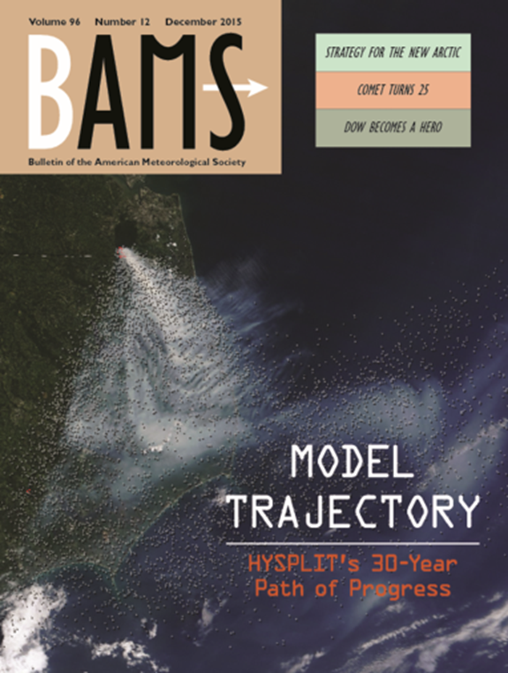
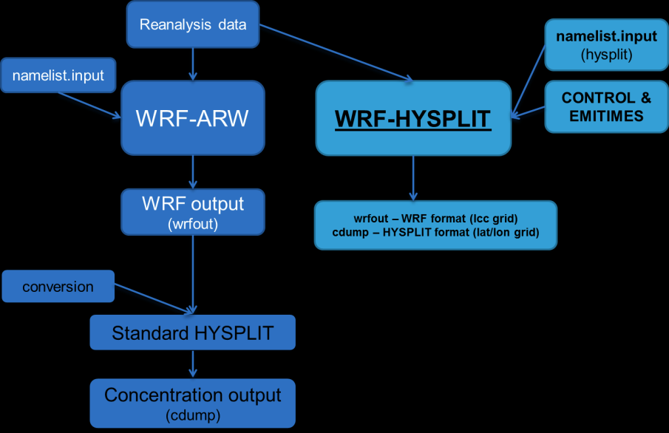
Approaches
The HYSPLIT model is the core of ARL’s transport and dispersion modeling capability.
General HYSPLIT improvements to computational performance, better representation of winds and turbulence on fine scales, and predicting dispersion in stable conditions.
In-line Dispersion Model development:
  ARL developed a version of the dispersion model that runs in-line with the prognostic meteorological model.
Notes:
HYSPLIT is the main tool that ARL develops and uses for dispersion modeling applications. Our main approach relies on incremental model improvements, based on new scientific knowledge, that are continuously tested against field measurements.
For instance, our group developed a HYSPLIT version that runs embedded within a meteorological model, avoiding spatial and temporal interpolation. This is a promising approach that is being tested on complex terrain dispersion applications.

Slide 6
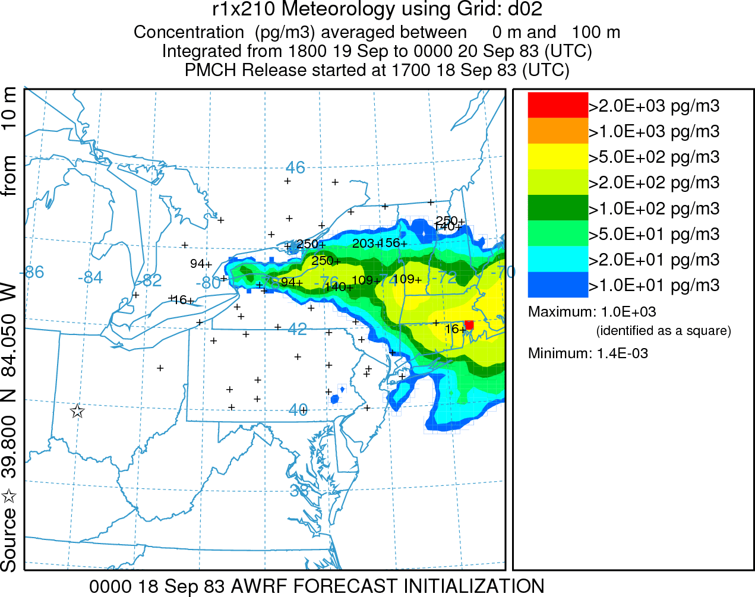
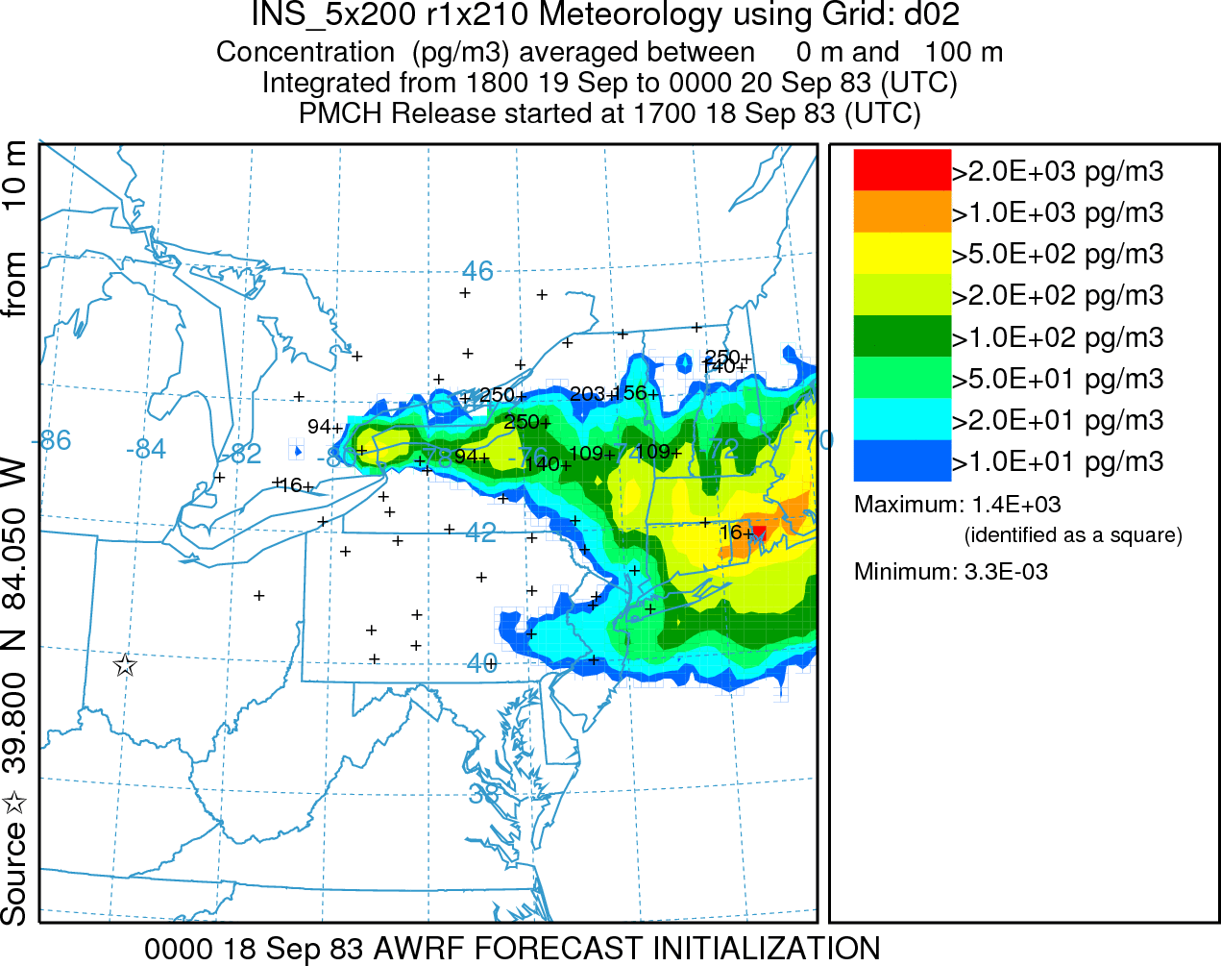
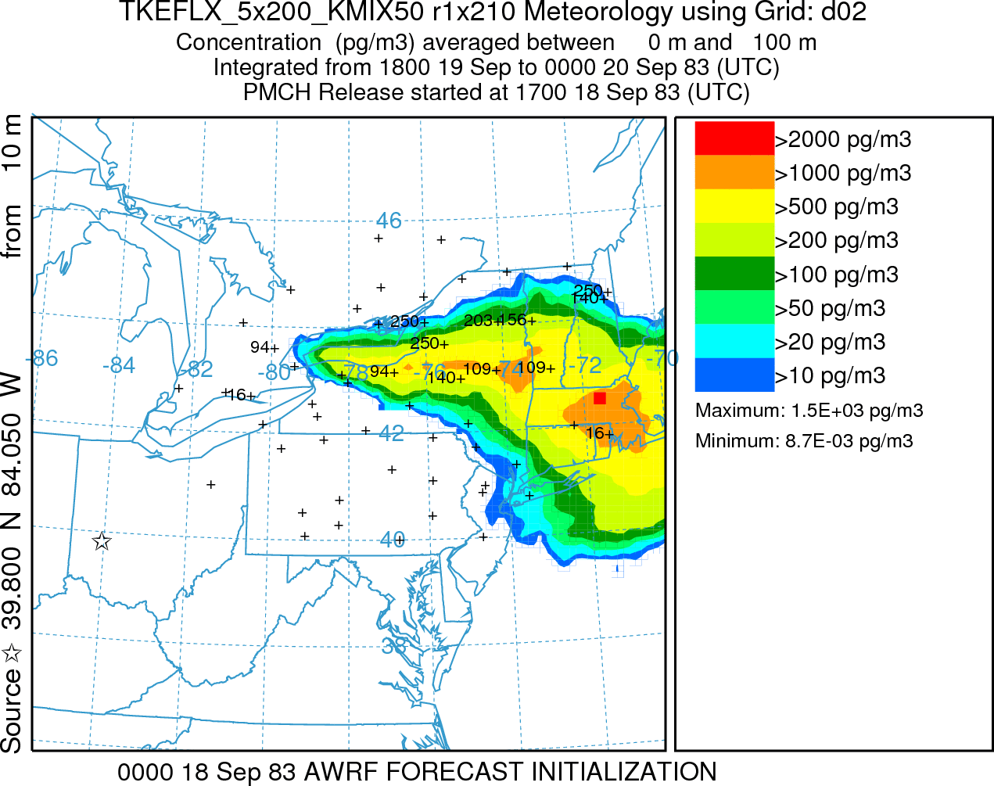
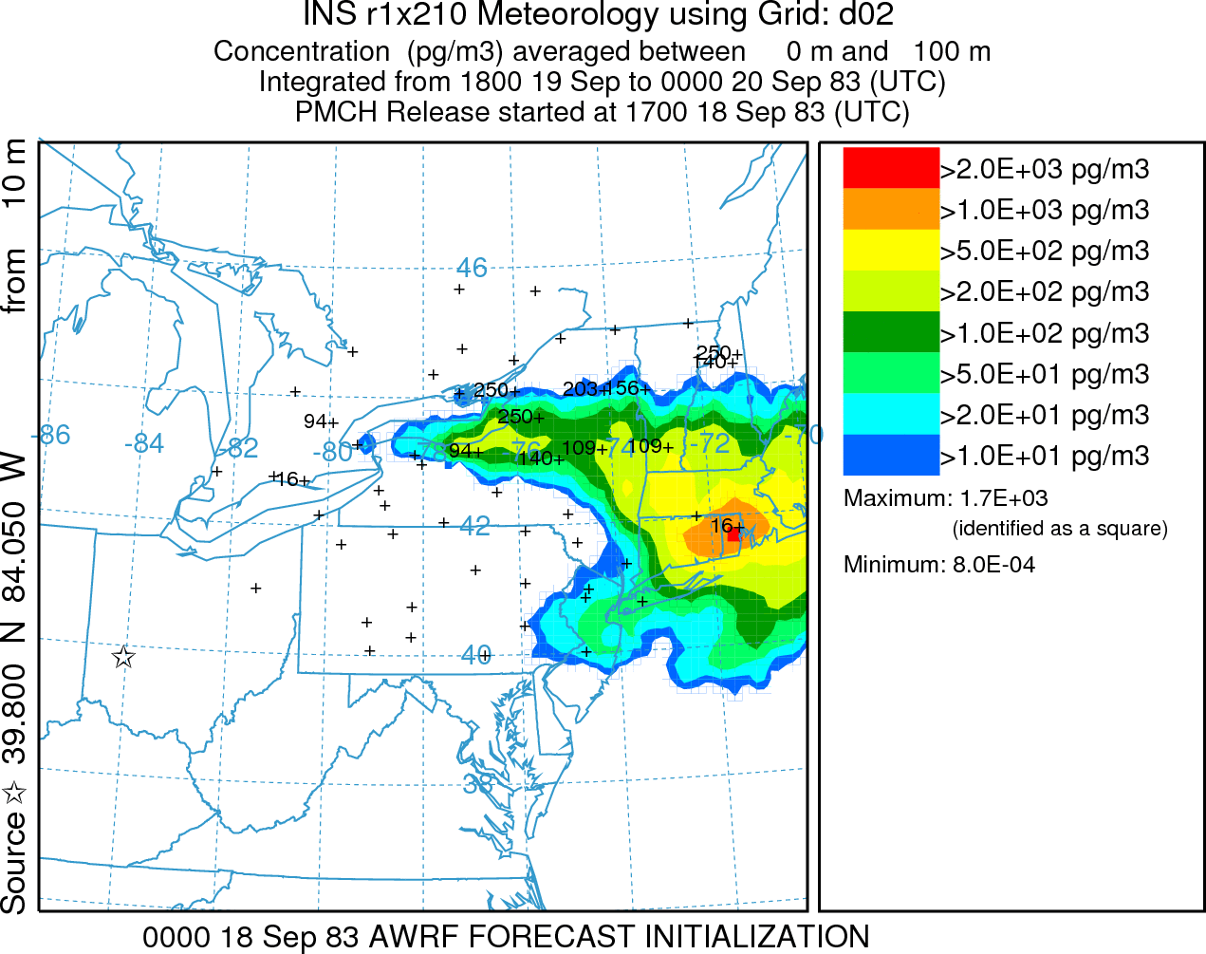
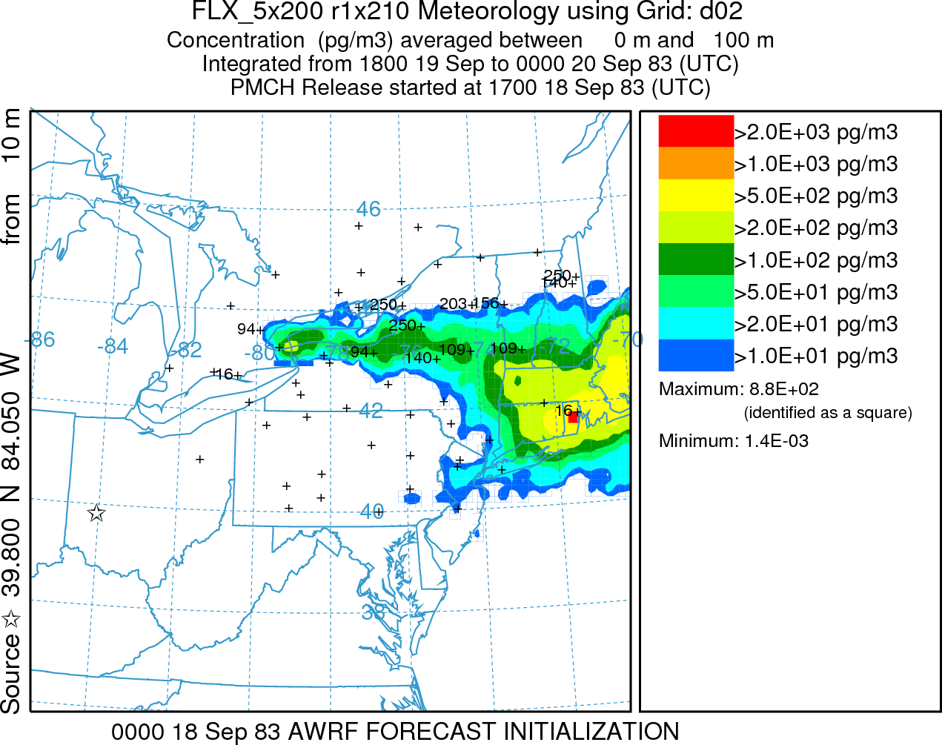
Approaches (cont.)
Data assimilation of in-situ or remote measurements:
  Assimilate measured air concentrations and/or satellite retrievals of, for example, volcanic ash mass loadings, into model predictions.
Source attribution:
  Estimate source location and strength. e.g.: Fukushima emission and climate forcing gasses reductions
Model ensembles:
  Assess the effect of uncertainties from source terms, meteorological fields, and ATD representations on resulting plume predictions.
Notes:
Also, we apply data assimilation techniques to improve model predictions of volcanic ash plumes using satellite retrievals.
Based on state-of-the-art inversion techniques we estimate source locations and strength for applications such as the Fukushima nuclear power plant accident and more recently to the estimation greenhouse gasses reductions.
In addition, we use dispersion modeling ensemble techniques to estimate and communicate uncertainties associated to the atmospheric transport and dispersion predictions.

Slide 7
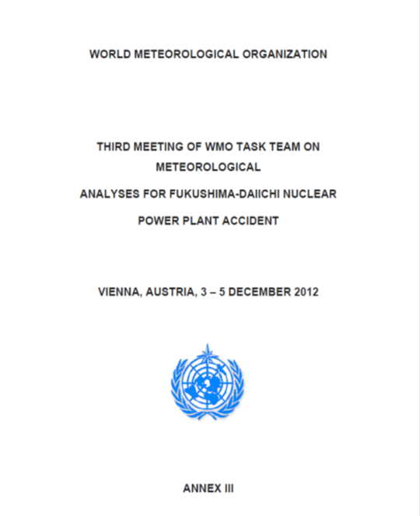
Accomplishments
Transfer new HYSPLIT model updates (smoke, dust, nuclear, volcanic ash) to National Weather Service operations. (Barbara Stunder’s poster)
Operationally implemented HYSPLIT Backtracking Capability for WMO/Comprehensive nuclear-Test- Ban Treaty Organization (CTBTO)
Lead WMO meteorological assessment of Fukushima Daiichi nuclear power plant accident
HYRad: Software Quality Assurance, Subcommittee on Consequence Assessment and Protective Actions (SCAPA) for DOE
In collaboration with the National Ocean Service’s (NOS) Office of Response and Restoration (OR&R), developed and transitioned to operations a joint HYSPLIT/ALOHA modeling system at the NOAA Web Operations Center. Used by the Weather Forecasting Offices (WFO) for local emergency response. (Glenn Rolph demo next)
Notes:
ARL continuously transfers new HYSPLIT model updates to the NWS operations. Point to Barbara’s poster.
Recently we operationally implemented HYSPLIT Backtracking Capability for the WMO/Comprehensive nuclear-Test- Ban Treaty Organization.
Also, during and after the Fukushima Daiichi nuclear plant accident ARL scientists lead the WMO meteorological assessment.
The HYSPLIT radiological (HYRad) modeling package was created to provide emergency response personnel and emergency planners at the Idaho National Laboratory (INL) with a set of software tools for rapidly evaluating the potential health and safety impacts of an airborne release involving radioactive material. HYRad complies with the SCAPA software quality assurance (SQA) guidance for safety-related and non-safety applications.
ARL, in collaboration with NOS’s OR&R, transitioned to operations the HYSPLIT/ALOHA system to NOAA’s Web Operations Center.
After my presentation, Glenn Rolph will present a demonstration of the operational web system that is used by the local Weather Forecasting Offices for emergency response.

Slide 8
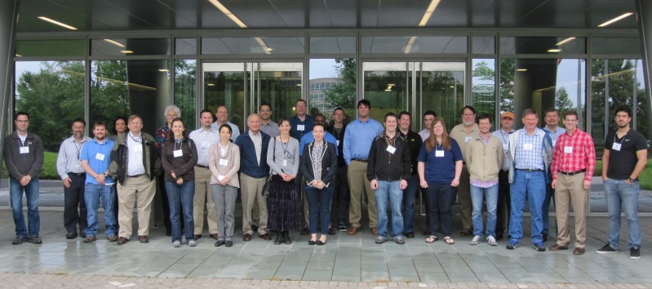
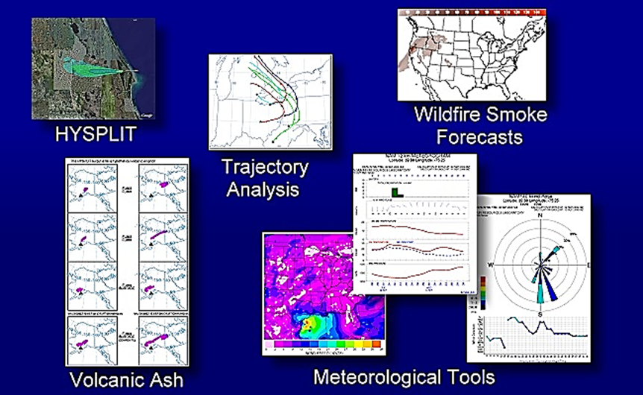
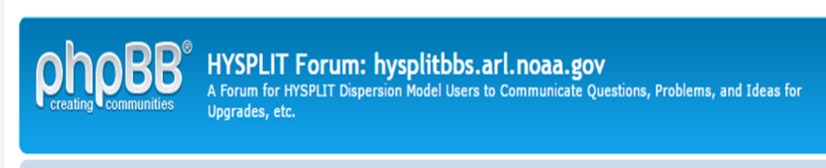
Relevance
3,500+ registered users from US and overseas from government, private sector, and academia
READY HYSPLIT web site usage:
  Average 60,000+ simulations/month. 1,000,000+ in 2014
  Meteograms in READY: ~10,000/day !!!!!
Training & outreach:
  Annual onsite HYSPLIT workshop
  Offsite national and international training
  Web forum with 3,000+ subscribers: 700+ questions answered
HYSPLIT peer literature reference:
  800+ references to Draxler and Hess, 1998. Source: Web of Science
  18 references to HYSPLIT BAMS Stein et al, 2015 (published in December, 2015)
  12,500 citations to HYSPLIT google scholar
READY - Real-time Environmental Applications and Display sYstem
Notes:
HYSPLIT continues to be one of the most extensively used atmospheric transport and dispersion models in the atmospheric sciences community (e.g., more than 800 citations to Draxler and Hess, 1998, Web of Science, http://thomsonreuters.com/thomson-reuters-web-of-science/).
The HYSPLIT modeling system can be currently run on PC, Mac, or Linux platforms using a single processor. Multiple processor parallelized environment calculations based on a Message Passing Interface (MPI) implementation are available for Mac and Linux. A registered version is also available that adds the capability of running the model with current (today’s) forecast meteorological data. About 3,500 registered users have already downloaded HYSPLIT.
Another way to gain public access to meteorological data and run HYSPLIT trajectory and dispersion simulations is through the Real-time Environmental Applications and Display sYstem (READY), a web-based system developed and maintained by ARL (http://ready.arl.noaa.gov/). READY brings together the trajectory and dispersion model, graphical display programs, and textual forecast programs generated over many years at ARL into a particularly easy to use form. Since its initial development in 1997 , thousands of users (about 60,000 HYSPLIT simulations per month) have generated products from READY for their day-to-day needs and research projects.
Every year HYSPLIT developers offer training workshops on the installation and use of the modeling system, including a wide variety of applications such as volcanic eruptions, radionuclide accidents, dust storms, wildfire smoke, and tracer experiments. Training materials, including a self-paced tutorial, are available at http://www.arl.noaa.gov/HYSPLIT_workshop.php. Workshop participants typically include members of the US and international governments, private industry, and academia.
National and interational training: ESRL (Boulder, CO), USFS (Asheville, NC), State of NY (Albany, NY), NWS/WFO (Wilmington, NC), University of Puerto Rico (San Juan, PR), ORNL (Oak Ridge, TN).
International training: Spain, Argentina, Mexico, Ireland, South Korea.
In addition, a Forum for HYSPLIT model users is available to communicate questions, problems, and experiences (https://hysplitbbs.arl.noaa.gov/). This Forum currently has more than 3,000 participants

Slide 9
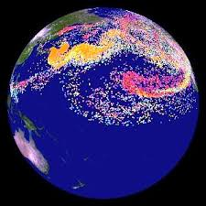
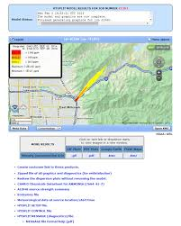
Relevance
Lead web development activities in WMO’s Regional Specialized Meteorological Center
HYSPLIT simulation from the Fukushima Daiichi nuclear power plant accident used on NOAA’s Science on a Sphere®
About 10 dispersion simulations/day for HYSPLIT/ALOHA modeling system at the NOAA WOC
Notes:
In addition, the HYSPLIT modeling group leads the web development activities with the Regional Specialized Meteorological Centers.
Moreover, the simulations performed for the Fukushima accident have been displayed on NOAA’s Science on a Sphere.
It is worth mentioning that the HYSPLIT/ALOHA modeling web system performs about 10 dispersion simulation per day. This system can only be accessed by NOAA.

Slide 10
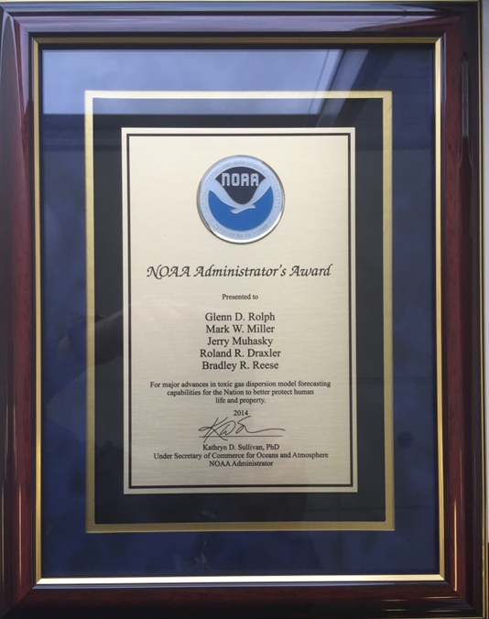
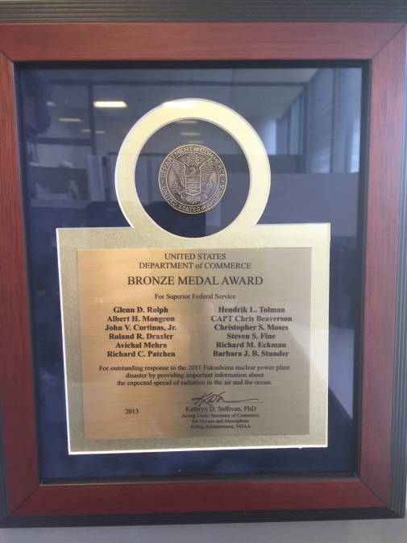
Quality
Roland Draxler received an OAR Employee of the Year Award – (2011)
NOAA Bronze Medal Award -- Glenn Rolph, Roland Draxler, Steven Fine, Barbara Stunder, Richard Eckman, et al. (2013) -- “For outstanding response to the 2011 Fukushima nuclear power plant disaster by providing important information about the expected spread of radiation in the air and the ocean.”
NOAA Administrator’s Award -- Glenn Rolph, Roland Draxler, Bradley Reese, et al. (2014) -- “For major advances in toxic gas dispersion model forecasting capabilities for the Nation to better protect human life and property.”
Notes:
Roland Draxler received an OAR Employee of The Year Award 2011 for his outstanding scientific contributions in the NOAA responses to the Deepwater Horizon oil spill (beginning April, 2010), the volcanic eruption of Eyjafjallajokull in Iceland (in April-May, 2010), and the Fukushima-Daiichi, Japan, nuclear power plant incident (April, 2011). In each of these very different events, Mr. Draxler quickly and efficiently adapted and applied HYSPLIT to address atmospheric releases and dispersion of harmful materials.
Also, in 2013 Glenn Rolph, Roland Draxler, Barbara Stunder and Rick Eckman received NOAA’s Bronze Medal Award. In 2014, Glenn, Roland and Brad Reese received NOAA Administrator’s Award.

Slide 11
Performance: transfer to operations
2011
  Multi-processor code
  New volcanic ash capabilities: time-varying eruption height and first-order initialization from ash observations
2013
  Add 4km NAM nest
  WOC ALOHA-HYSPLIT implementation
2014
  Add Comprehensive Test Ban Treaty Organization (CTBTO) capability
  Change smoke from horizontal-puff vertical-particle to 3-d particle simulation
  Pre-computed random numbers
  Option to use variable Lagrangian time scale
  Default large-scale emergency response to use half-degree native-hybrid-level GFS
Notes:
ARL has continuously and consistently transferred transport and dispersion products to the NWS. Here are some examples of recent operational implementations. It is worth mentioning the new ALOHA-HYSPLIT and the Comprehensive Test Ban Treaty Organization capability.

Slide 12

Challenge: HYSPLIT Continuity
Roland Draxler retired in 2015
Ariel Stein new HYSPLIT group lead
3 new CICS-UMD scientists: Fantine Ngan, Alice Crawford, and Tianfeng Chai
Notes:
Roland Draxler was the creator and main developer of HYSPLIT. Although his retirement in 2015 created a big scientific and personal void, the HYSPLIT team has managed to continue developing, applying and providing support for the model. Over the last 5 years we incorporated 3 new scientists that actively contribute to the scientific improvement of the HYSPLIT model.

Slide 13
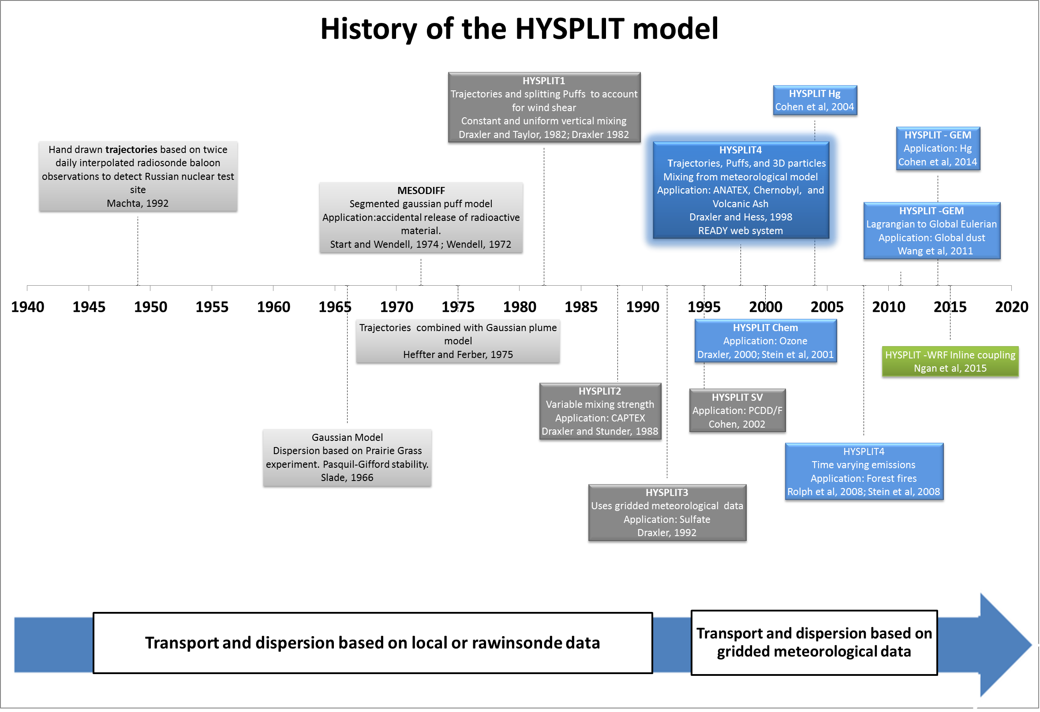

Notes:
- The scientific foundation and inspiration for HYSPLIT’s trajectory capabilities can be traced back to 1949, when the Special Project Section (SPS) (ARL’s predecessor) of the U.S. Weather Bureau (now NOAA’s National Weather Service (NWS)) was charged with trying to find the source of radioactive debris originating from the first Soviet atomic test and detected by a reconnaissance aircraft near the Kamchatka Peninsula. For that purpose, back trajectories were calculated by hand based on wind data derived from twice-daily radiosonde balloon measurements. These trajectories followed 500 mb heights assuming geostrophic wind flow. Although these back trajectories were calculated more than 60 years ago, the percentage error between the calculated and actual source location relative to the distance covered by the trajectories was remarkably low (about 5%; Machta, 1992). Since then, trajectory calculations have been one of the backbones of ARL’s research activities.
- The HYSPLIT model evolved from MESODIFF, a segmented gaussian puff model that was used in Idaho for consequence assessment after the accidental release of radioactive material.
- Early versions of HYSPLIT based the dispersion calculations on interpolated meteorological observations, until HYSPLIT version 3 started using gridded meteorological data.

Slide 14
HYSPLIT 4
Automated method of simultaneously using multiple meteorological grids
Pre-processors for many different meteorological models (WRF, RAMS, MM5, ECMWF) to convert data to the ARL format, in addition to the archives of existing NOAA models
Multiple parameterizations to estimate the stability from gradients of meteorological variables
Multiple options to convert stability into dispersion values (diffusivity profiles, turbulent kinetic energy, velocity variance)
Modeling the turbulent particle motion directly (3D) or the change in the statistic of the particle distribution (puffs)
Version 4 of HYSPLIT has been the basis for the construction of essentially all model applications for the last 15 years
Notes:
By the end of the 1990s, many significant new features had been incorporated into the modeling system.
HYSPLIT version 4 (HYSPLIT4; Draxler and Hess, 1998), which is the basis for current model versions, includes an automated method of sequentially using multiple meteorological grids going from finer to coarser horizontal resolution and the calculation of the dispersion rate from the vertical diffusivity profile, wind shear, and horizontal deformation of the wind field. HYSPLIT4 allows the use of different kinds of Lagrangian representations of the transported air masses: 3-dimensional (3D) particles, puffs, or a hybrid of both. A 3D “particle” is a point, computational mass – representing a gaseous or particulate-phase pollutant – moved by the wind field with a mean and a random component. Individual 3D particles never grow or split, but a sufficient number needs to be released to represent the downwind horizontal and vertical pollutant distribution. A single puff, on the other hand, represents the distribution of a large number of 3D particles by assuming a pre-defined concentration distribution (Gaussian or Top-Hat) in the vertical and horizontal directions. Puffs grow horizontally and vertically according to the dispersion algorithms for puffs (see Draxler and Hess (1998) for details), equivalent to the evolving distribution of particles in a comparable 3D particle calculation. Furthermore, puffs split if they become too large (i.e. cannot be represented by a single meteorological data point). To avoid the puff number quickly reaching the computational array limits, puffs of the same age occupying the same location may be merged. An alternative approach is to simulate the dispersion with a 2D object (planar mass, having zero vertical depth), in which the horizontal contaminant has a puff distribution, growing according to the dispersion rules for puffs and splitting if it gets too large. In the vertical, however, they are treated as Lagrangian particles. This option permits the model to represent the more complex vertical structure of the atmosphere with the higher fidelity possible when using particles while representing the more uniform horizontal structure using puffs.

Slide 15
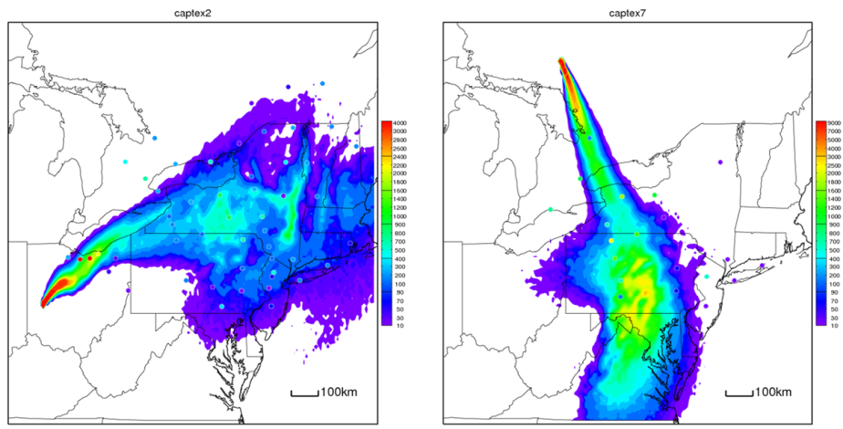
Model Evaluation
Data Archive of Tracer Experiments and Meteorology (DATEM)
Approach
  North American Regional Reanalysis (NARR) and several with WRF runs
  Creating new WRF
  Common statistical evaluation protocols
Accomplishments
  Web access to run HYSPLIT for each experiment
  Standardized model change testing in conjunction with version control
Cross Appalachian Tracer Experiment (CAPTEX)
Dayton, OH, and Sudbury, ONT, Sep., Oct., 1983
Atlantic Coast Unique Regional Atmospheric Tracer Experiment (ACURATE), Savannah River Plant, SC, Spring 1982 – Summer 1983
Across North America Tracer Experiment (ANATEX), Glasgow, MT, and St. Cloud, MN, January through March 1987
Oklahoma Tracer Experiment, Norman, OK, July, 08 1980
Metropolitan Tracer Experiment (METREX) , Washington, DC, January – December 1984
European Tracer Experiment (ETEX), Rennes, France, October 23, 1994
Savannah River Plant Experiment , Aiken, SC, Aug. 1975 through Sep. 1977
Atmospheric Studies in Complex Terrain (ASCOT) , California, September 12-25, 1980
Colorado Springs Tracer Experiment (COSTEX), October 18, 21, 23, 2010
Sagebrush, Idaho, 2013.
Notes:
Tracer experiments are fundamental for model testing. 9 tracer experiments that include a wide range of spatial scales are available in a uniformed format for model evaluation.
A common theme for decision support is that individual model users need to understand the effects of changing model parameters, meteorological data, and other assumptions. The first step of this process was accomplished some time ago by standardizing the format of each of the ARL-HQ tracer experiments and providing model ready meteorological data for each experiment. This project was called Data Archive of Tracer Experiments and Meteorology (DATEM) and initially provided public anonymous FTP access to all the data files. The experiments available include a wide range of durations and distances: from the urban scale Metropolitan Tracer Experiment (METREX), to the continental scale Across North America Tracer Experiment (ANATEX). More recently, we have updated the web interface, to permit anyone to actually run HYSPLIT against any of the experiments. With the availability of the higher resolution 32-km North American Regional Reanalysis, these simulations become more realistic than what was available previously (2.5 degree data). As part of the web evaluation, a common set of statistical analyses are performed on the results of each simulation. Users can determine the sensitivity of changing model parameters and determine the accuracy of the calculation for experiments that approximate their interests.

Slide 16
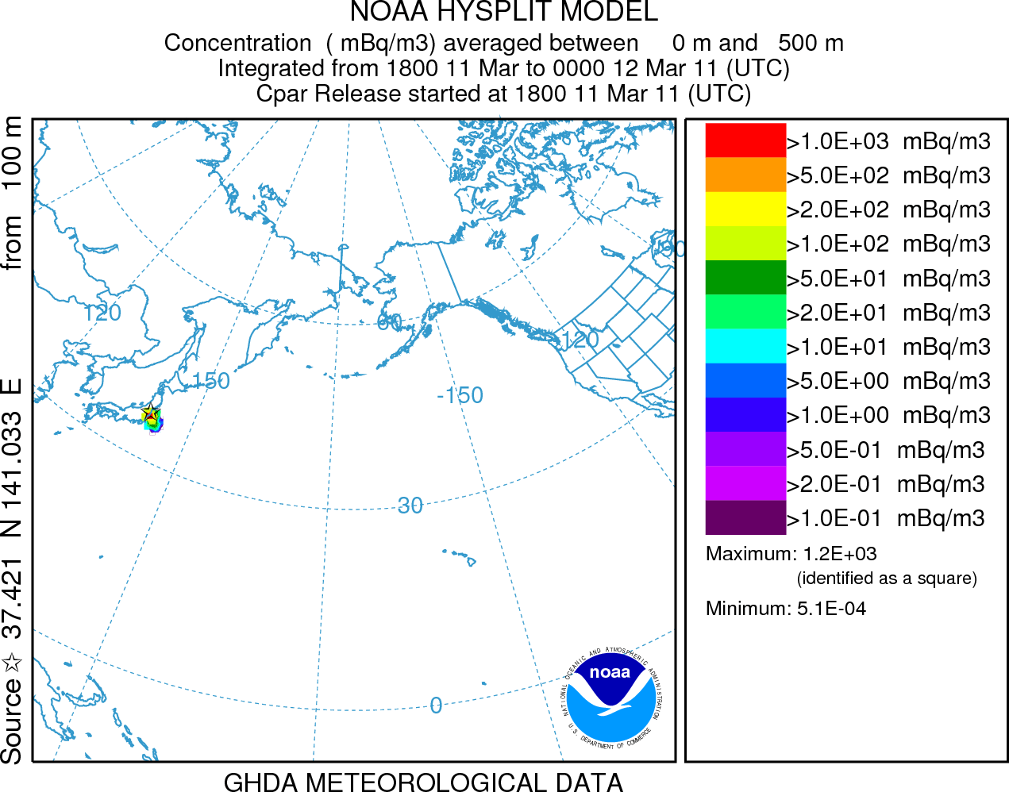
Emergency Response
Nuclear accidents
Background
  Lack of communication between countries after Chernobyl accident 1986
Approaches
  Comprehensive Test Ban Treaty Organization (CTBTO) - WMO Backtracking Response System - US Dep. Of State and NOAA MOA
  Regional Specialized Meteorological Centers (RSMC) – WMO - NWS and OAR
Applications
  Fukushima-Daiichi power plant accident 2011.
  NRC/ARL MOU integrate the HYSPLIT code into MELCOR Accident Consequence Code System (MACCS) as an alternate ATD model
  EPA/ARL modeling support and training
  HYSPLIT installed in Australia and China
Notes:
One of the original HYSPLIT emergency response applications was in the support of accidental radionuclide releases. This was prompted by the Chernobyl accident where a lack of communication among European countries prompted the International Atomic Energy Agency (IAEA) to request the World Meteorological Organization (WMO) to establish a group of operational National Meteorological Services (NMS) that could provide dispersion forecast products. There are now eight Regional Specialized Meteorological Centers (RSMC) for transport model products host by various countries. NOAA operates one of those. HYSPLIT is also the primary RSMC dispersion model at the Australian Bureau of Meteorology (BoM) and the China Meteorological Administration (CMA). A relatively new HYSPLIT application is to use an above-background measurement value as a starting point for an adjoint (backward integration of the dispersion model) to identify potential source locations. This is the approach taken by the Comprehensive Test Ban Treaty Organization (CTBTO) to analyze their monitoring network data. HYSPLIT is one of the models available to the CTBTO.
Although the model’s performance for the Chernobyl accident was reasonable, soon after the first observational data started to come after the Fukushima accident, it was clear that HYSPLIT was substantially over-predicting the wet deposition. A simple reduction by about a factor of ten (3x10⁵ to 4x10⁴) of the in-cloud scavenging ratio reduced the over-prediction but did not address the cause. The main difference between the two accidents was that the Fukushima release was relatively near the ground compared with the Chernobyl release, where a continuing fire lofted material much higher into the atmosphere. The Cs-137 deposition measurements are shown in the left panel, averaged together from aircraft monitoring and ground based sampling and the model prediction is shown in the right panel. Although there are differences in the measured and observed patterns, the overall structure and magnitudes are comparable.

Slide 17
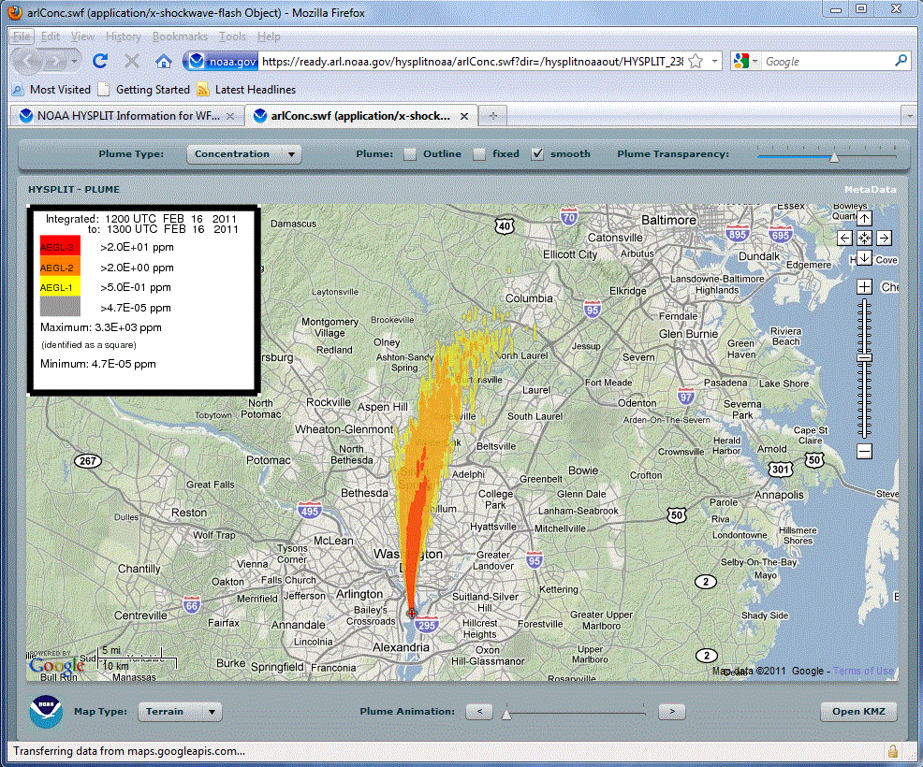
Emergency Response
Chemical Releases (Glenn Rolph’s demonstration)
Background
  Post 9/11 applications for forecast offices centrally run
Approaches
  Link to Computer-Aided Management of Emergency Operations (CAMEO) chemicals data
  Collaboration with Office of Response and Restoration (OR&R) to include Areal Locations of Hazardous Atmospheres (ALOHA) source model
Applications
  Incorporating real-time chemical plume modeling capability through the web for WFOs
Notes:
The interest in applying HYSPLIT to more shorter-range problems increased after 9/11 with a request by the National Weather Service for routine HYSPLIT forecasts at a number of fixed locations. At the same time an on-demand capability was established through the 24/7 desk of the Senior Duty Meteorologist at the National Centers for Environmental Prediction (NCEP). The response was initiated by a telephone call to the SDM, manual data entry, and the posting the results to a secure web page. The approach proved to be cumbersome and a dedicated system for Weather Forecast Office access was developed, hosted at NOAA’s 24/7 web portal. A unique feature of this interface is that it links the Computer-Aided Management of Emergency Operations (CAMEO) chemicals data base with HYSPLIT, permitting the WFO to select a realistic emission scenario and create output graphics linked with human exposure guidelines. A newer version exists that was developed in collaboration with the National Ocean Service’s Office of Response and Restoration to include the source modeling features of their Areal Locations of Hazardous Atmospheres (ALOHA) model as part of the HYSPLIT chemical modeling package.
CAMEO - http://cameochemicals.noaa.gov/
ALOHA - http://www.epa.gov/emergenciescontent/cameo/aloha.htm

Slide 18
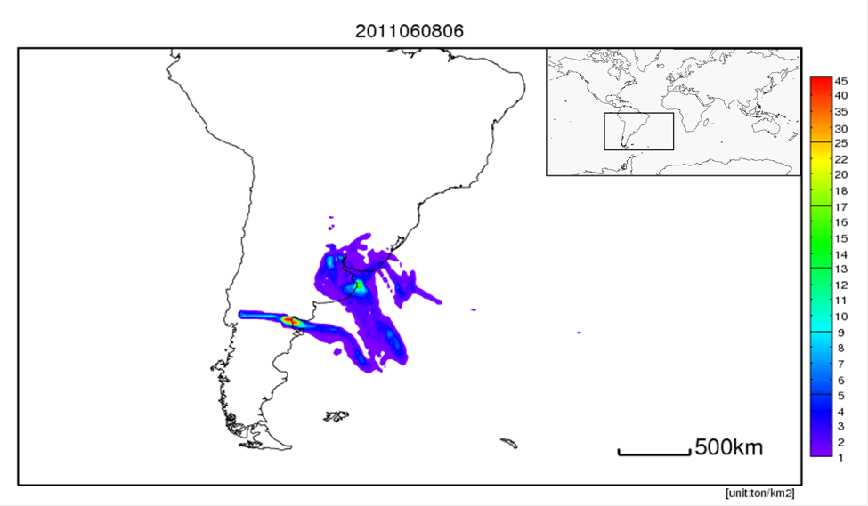
Emergency Response
Volcanic Eruptions (Alice Crawford’s poster)
Background
  Mt. St. Helens – forecast trajectories to the USGS
  Mt. Redoubt – KLM encounter
Approaches
  Source term uncertainty (mass, particle size, height)
  Quantitative air concentration
  Assimilation of satellite data
Applications
  International Civil Aviation Organization – FAA - Washington Volcanic Ash Advisory Center (NCEP and NESDIS)
  HYSPLIT installed in Australia, New Zealand, Argentina, and AFWA
Notes:
ARL’s involvement with modelling the ash and other debris from a volcanic eruption goes back to Mt. St. Helens, where we just provided trajectory forecasts (using the Limited Fine Mesh (LFM) model). The concerns with forecasting ash movement became more serious after the KML aircraft encounter with the Mt. Redoubt plume and the arrangements became more formal. HYSPLIT is the current plume model for the Washington Volcanic Ash Advisory Center (VAAC), the Air Force Weather Agency (AFWA), as well as for the VAACs in Australia, New Zealand and Argentina.
Although volcanic ash modelling easily lends itself to Lagrangian approaches due to the point-source nature of the problem, there is considerable uncertainty in the source term mass, particles sizes, and plume heights. These can affect the transport direction and limit the development of a more quantitative prediction, a potential new requirement as a result of the large scale shutdown of air traffic as a result of the Eyjafjallajokull eruption. We are collaborating with the National Environmental Satellite Data Information Service (NESDIS) to toward incorporating better satellite based eruption and ash cloud distribution data for model initialization. Point to Alice’s poster.
Barbara J.B. Stunder, Jerome L. Heffter, Roland R. Draxler, 2007, Airborne Volcanic Ash Forecast Area Reliability, Weather and Forecasting, 22:1132-1139

Slide 19
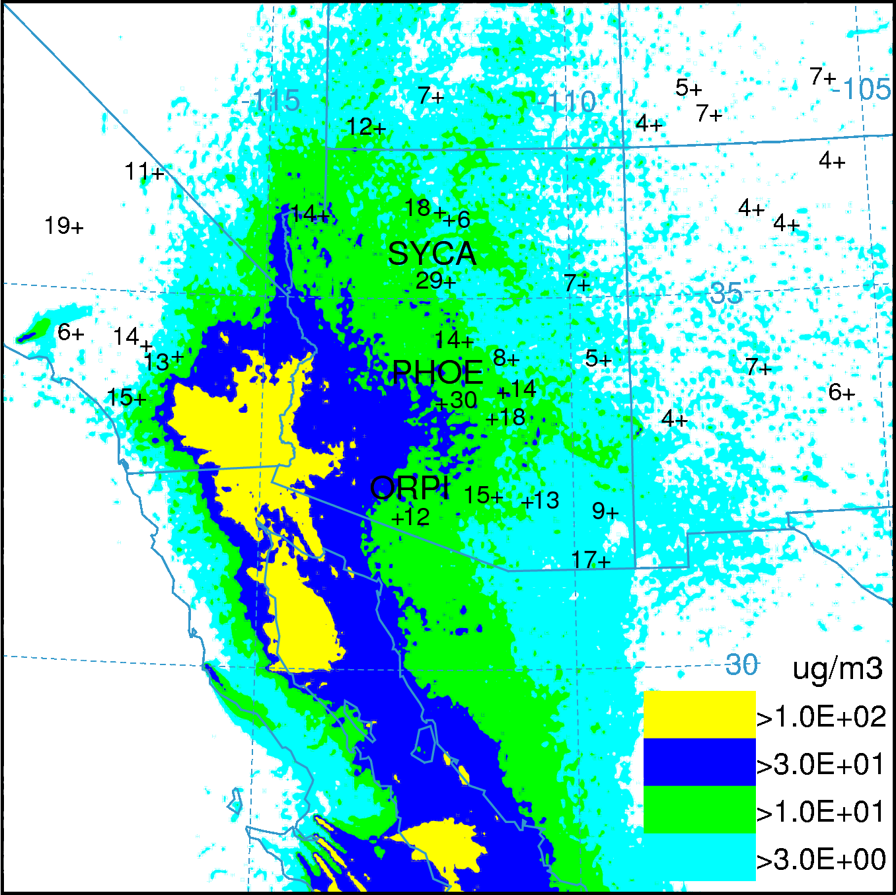
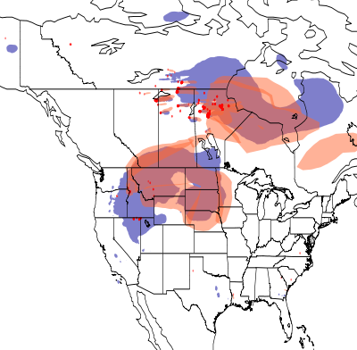
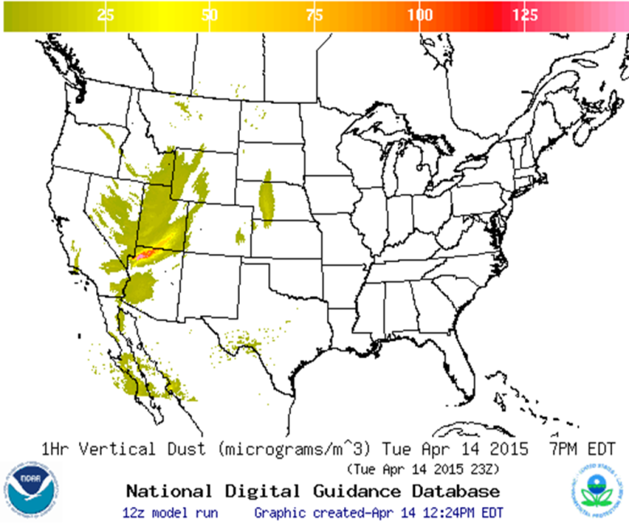
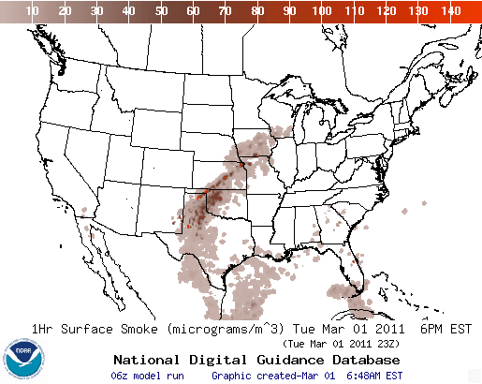
Forecasting Transport of Dust and Smoke
Notes:
NOAA Smoke Forecasting System
The NOAA Smoke Forecasting System integrates the NOAA National Environmental Satellite, Data and Information Service's satellite information on the location of wildfires with NOAA National Weather Service weather inputs from the North American Mesoscale model and smoke dispersion simulations from the NOAA ARL HYSPLIT model to produce a daily 48-hour prediction of smoke transport and concentration. The model also incorporates U.S. Forest Service estimates for wildfire smoke emissions based on vegetation cover. This system is intended as guidance to air quality forecasters and the public for primary fine particulate matter emitted from large wildfires and agricultural burning which can elevate particulate concentrations to unhealthful levels.
NOAA Dust Forecasting System
ARL scientists developed a dust emissions algorithm based on a 5-year climatology from the MODIS Deep Blue satellite observations. These emissions in conjunction with the meteorological fields generated by the North American Mesoscale model are used by the HYSPLIT model to estimate the transport, dispersion and deposition of dust over the continental US.

Slide 20
Inline versus Offline (Fantine Ngan’s poster)
Comparison of inline and offline approaches
 | Inline HYSPLIT | Offline HYSPLIT
Source of met. input | WRF-ARW | Varying met. data (WRF, MM5, NARR, etc); Need conversion programs for each
Met. input frequency | The meteorology is used at WRF’s time step, which could be seconds. No temporal interpolation . | WRF’s output (hourly or in minute intervals) interpolated to the HYSPLIT time step.
Vertical grid | Using WRF’s terrain-following hydrostatic vertical coordinate. No vertical interpolation. | A terrain-following coordinate using a equation between height & model level; then interpolating data to HYSPLIT’s layers
Horizontal grid | Following WRF’s grid configuration. | Same as the meteorological data grid.
Disk usage | Dispersion output and WRF output based on users’ request. | Large cost of data storage if high temporal resolution data are needed.
Multiple simulations | Requires repeating the meteorological simulation. | Only one meteorological simulation is required.
Notes:
There are many advantages to including the dispersion calculation within the meteorological calculation, especially in terms of eliminating the need for interpolation and the ability to capture rapid temporal changes in the weather conditions. Introduce Fantine’s poster.
However, calculations over long time periods or those requiring repeated simulations, perhaps with different pollutant source characteristics, are best performed using archived meteorological data. Therefore, one important aspect of this activity is to identify meteorological variables or other parameterizations in the meteorological code that can be adapted into the dispersion code to reduce the differences between inline and offline calculations.

Slide 21
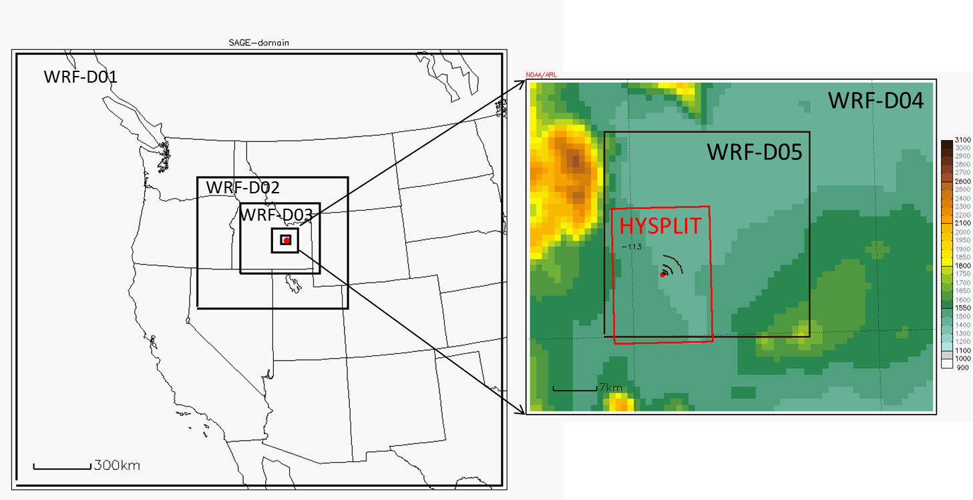
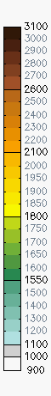
HYSPLIT simulation of Sagebrush experiment
(Collaboration FRD-HQ)
Shaded color – terrain height
Red dot – release location
Small black dots – sampling network
Horizontal grid: 27km, 9km, 3km, 1km and 333m
Vertical coordinate: 33 layers with the 1st mid-layer at around 8m and 20 layers included below 850 hPa.
Simulation period: 2013/10/07 00UTC – 10/08 00UTC
21
Notes:
As an example of the application of the WRF-HYSPLIT inline system we modeled the Sagebrush experiment conducted in Idaho by FRD. The experiment consisted of 5 SF6 releases with measurements taken in arches with a maximum separation of 3.2 km. We analyzed release #3.

Slide 22
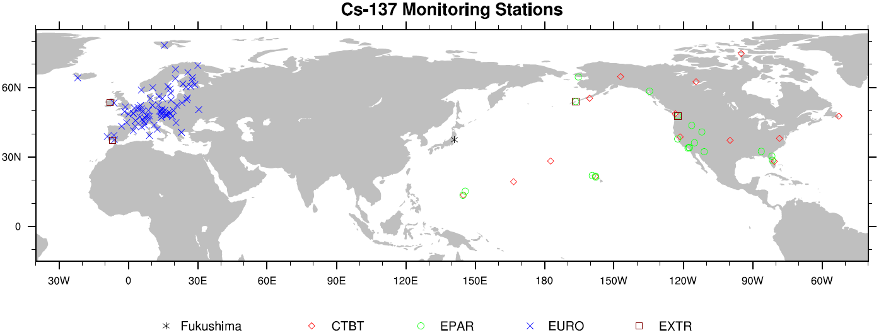
HYSPLIT inverse modeling
(Tianfeng Chai’s poster)
1. Fukushima source term estimation
Ref: Source term estimation using air concentration measurements and a Lagrangian dispersion model–Experiments with pseudo and real cesium-137, T Chai, R Draxler, A Stein – Atmos. Environ., 2015
2. Volcanic ash application - Kasatochi eruption
Notes:
An additional research topic is the use of inversion methodologies to assess source attributions by minimizing a cost function. Here are two applications of this technique: 1. The emission rate corresponding to Fukushima nuclear power plant accident was reconstructed using global measurements of Cs-137. 2. The emission strength and vertical distribution at the source corresponding to the eruption of the Kasatochi volcano was estimated using satellite ash loadings measured downwind of the eruption. For more details see Tianfeng’s poster.

Slide 23
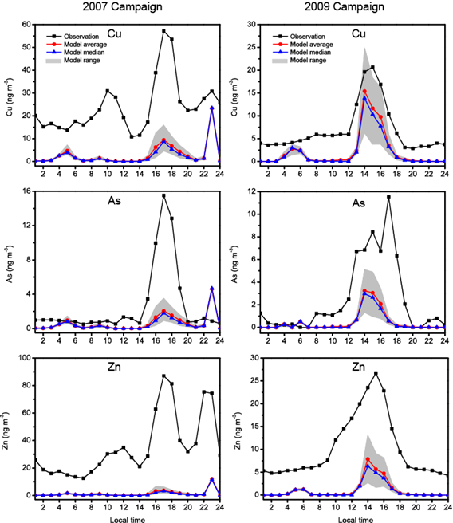
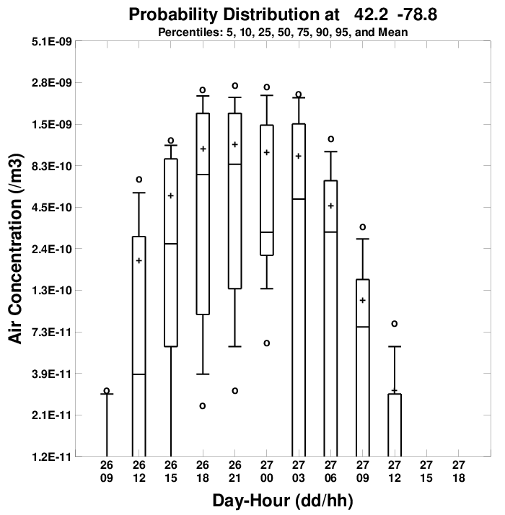
Dispersion Model Ensembles (Ariel Stein’s poster)
Increasingly attractive approach to study atmospheric transport in the lower troposphere to improve plume simulations and assess their uncertainty
HYSPLIT has a built-in capability to produce different simulation ensembles
Studying ways of determining the optimum number of multi-model members and/or individual model physical features to vary is the primary difficulty to overcome when constructing ensembles
Notes:
The other issue currently under investigation is the development of methods to assess the uncertainty for a plume transport and dispersion prediction.
The traditional approach to this problem is to generate ensembles; multiple simulations each with slightly different assumptions. Creating ensembles is only one step in the process. There are many ways ensembles can be created and the approach depends in part which component the user feels contributes the most uncertainty to the results for this particular application.
Three ensemble generation methods that are internal to HYSPLIT. In addition, a simple and very effective ensemble can also be constructed by simply using different sources of meteorological data.
“Meteorological Grid” ensemble, created by slightly offsetting the meteorological data to test the sensitivity of the advection calculation to the gradients in the meteorological data fields
“Turbulence” ensemble, represents the uncertainty in the concentration calculation arising from the model’s characterization of the random motions created by atmospheric turbulence
“Physics” ensemble, built by varying key physical model parameters and model options within the dispersion model
We are currently studying efficient ways of creating more accurate and diverse ensembles for transport and dispersion applications in particular.

Slide 24













Collaborations
NOAA:
  NWS: nuclear, volcanic ash, dust, smoke
  NOS OR&R/ WOC: ALOHA-HYSPLIT, chemical
  NESDIS VAAC: volcanic ash
  GMD / ESRL: Regional climate forcing gases inversion (CH4, CO2, etc)
NIST/DOC:
  Urban climate forcing gases inversion (CH4, CO2, etc)
EPA:
  Effect of foreign nuclear accidents on US interests
NRC:
  Severe nuclear accident consequence assessment
DOD:
  CTBTO support
USFS AirFire Research Team website:
  Forest fires and prescribed burns
Univ. of Hawaii
  VOG Volcanic smog predictions
Univ. of Huelva:
  Dust originating from Africa
  High resolution heavy metal’s simulations
  HYSPLIT Spain web mirror
Argentina VAAC and RSMC:
  HYSPLIT updates for volcanic ash and nuclear applications
Australia (BOM) RSMC:
  HYSPLIT model updates for nuclear dispersion applications
Ireland
  HYSPLIT updates and training for nuclear accident applications
CSIRO Australia
  Tool for Assessing Pest or Pathogen Airborne Spread (TAPPAS)

